Slide 1
CATM - SPOJ

Slide 2
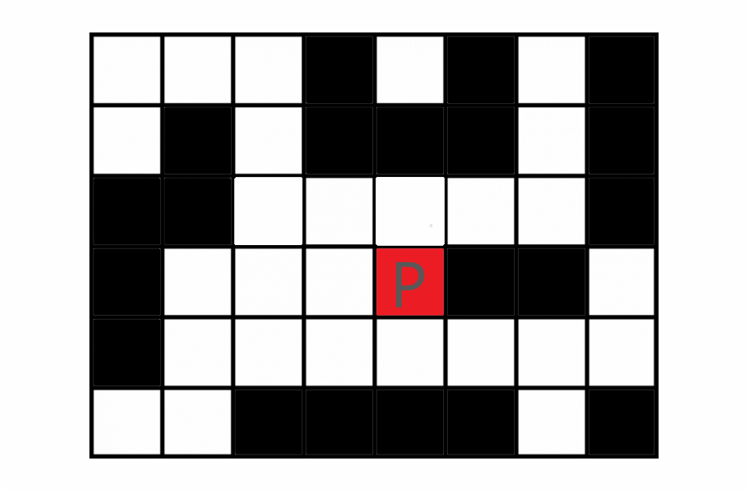
Shortest path for James Bond from initial Position

Slide 3
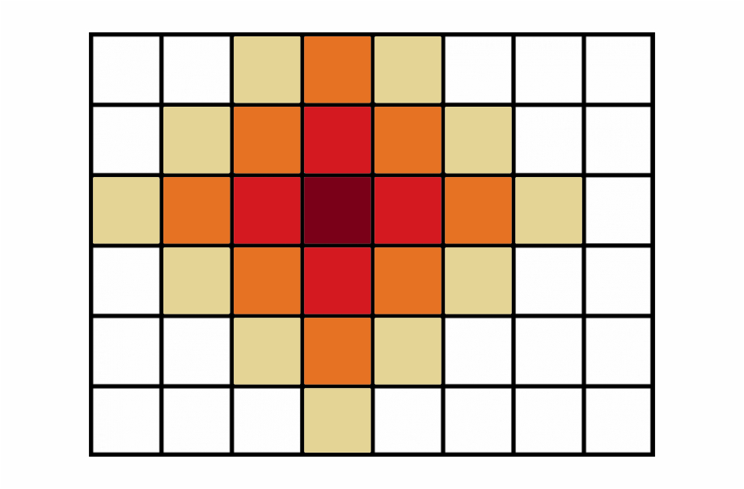
How something propagates

Slide 4
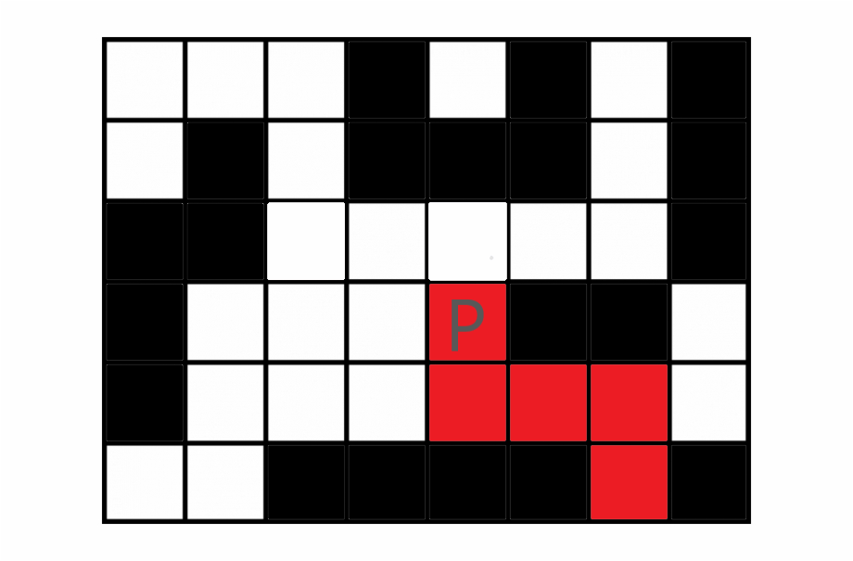

Slide 6
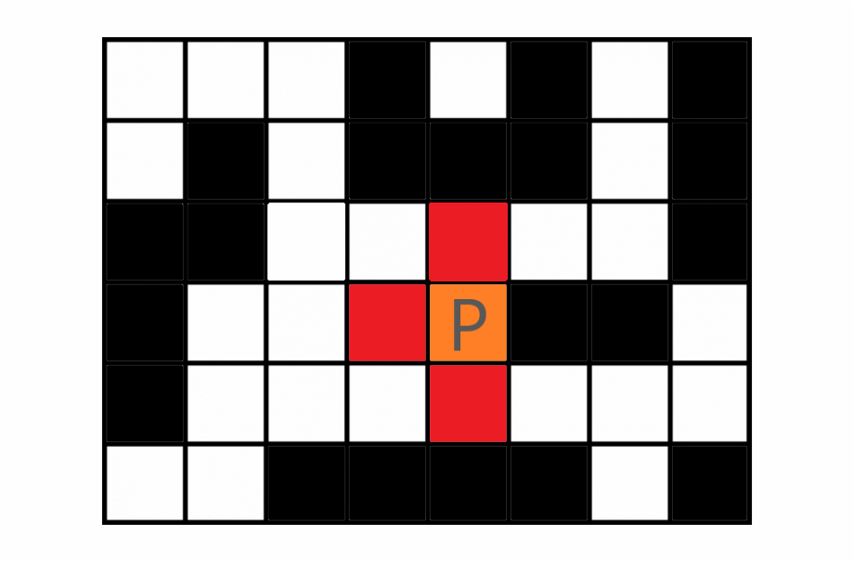
1
1
1

Slide 7
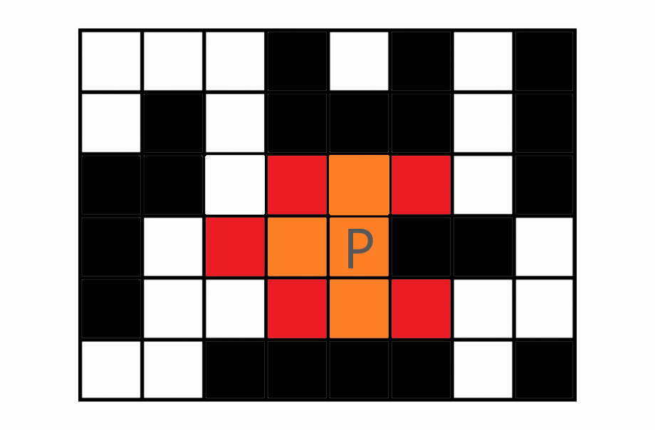
2 2
2
2 2
1
1
1

Slide 8
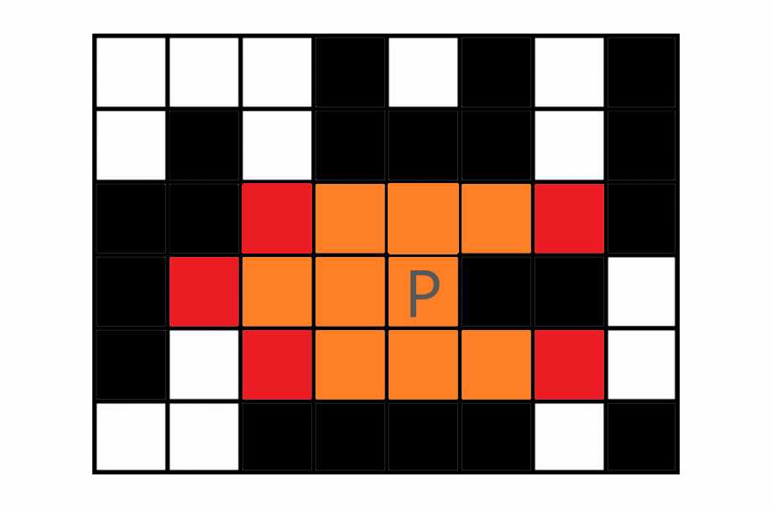
3 3
3
3 3
2 2
2
2 2
1
1
1

Slide 9
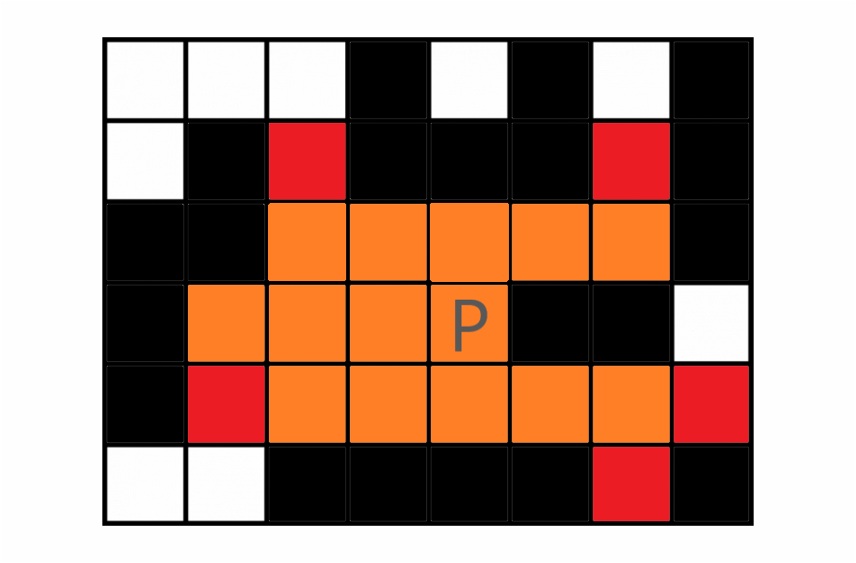
4 4
4 4
4
3 3
3
3 3
2 2
2
2 2
1
1
1
In next move, we can escape through this point

Slide 10
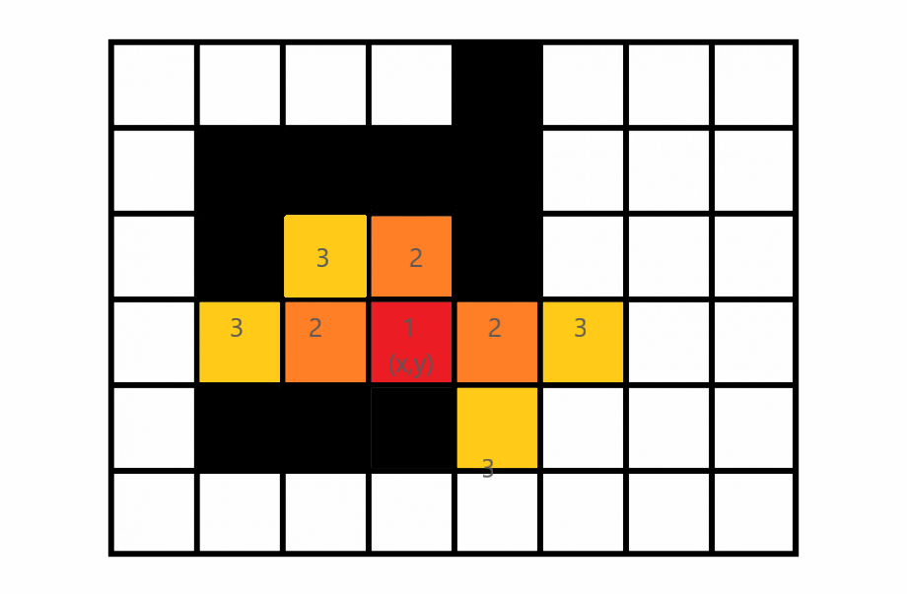
Int main()
{
Queue with point (x,y)
}
[x,y]
[x,y-1] [x,y+1] [x-1,y]
[x-1,y] [x-1,y-1] [x+2,y] [x+1,y+1]
Notice that the an already added point is not added again.

Slide 11
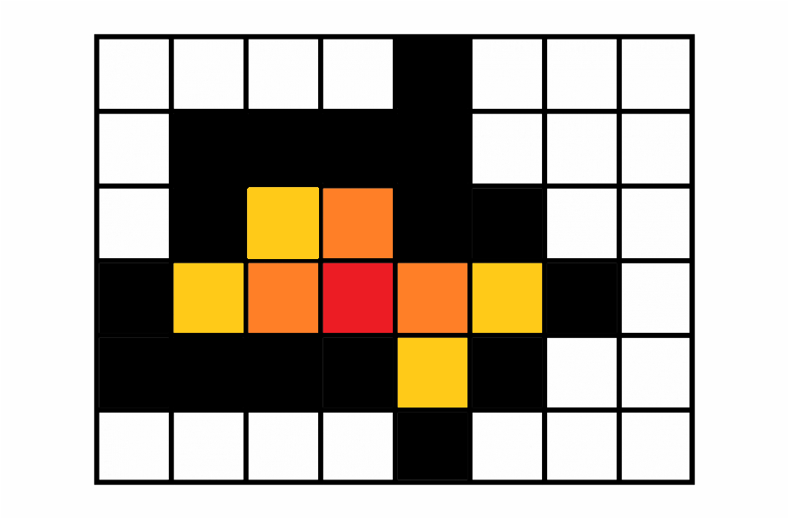
Another Case- Soon our James Bond has no place to go, he can’t escape. (What is time Complexity?)
[x,y]
[x,y-1] [x,y+1] [x-1,y]
[x-1,y] [x-1,y-1] [x+2,y] [x+1,y+1]
--empty--

Slide 12
When no new point as in last case.
When James Bond finds a Path
When to break

Slide 13
Present the question CATM (spoj)
We Need to check for every path.
If one of the path is safe then we can say that Mouse can safely exit.

Slide 14
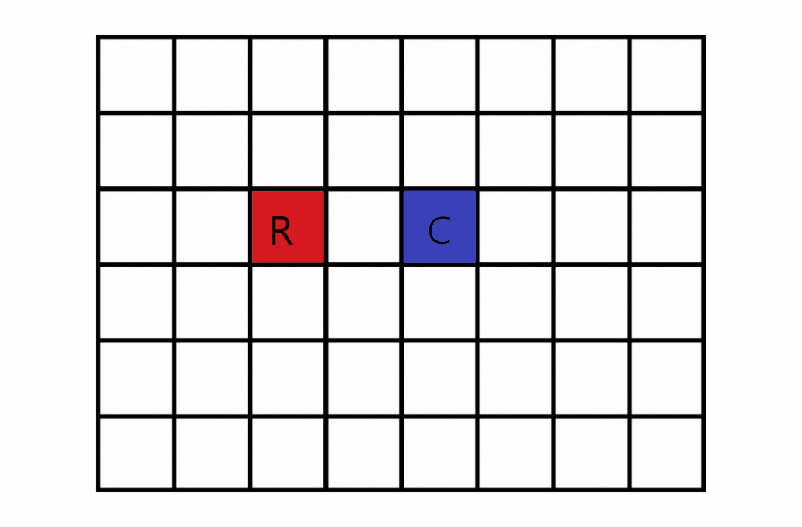

Slide 15
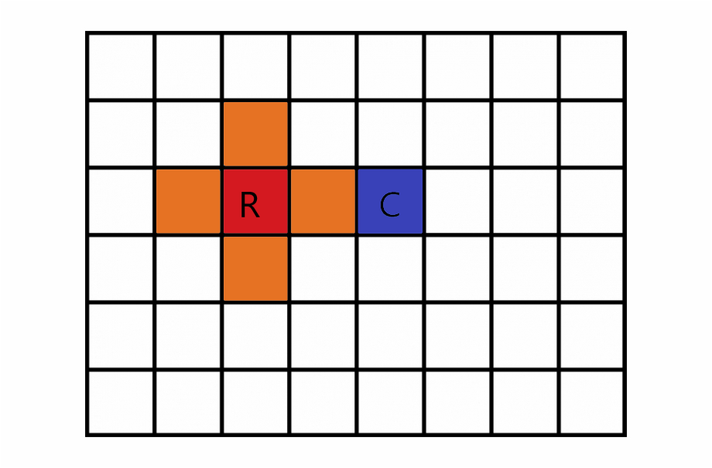

Slide 16
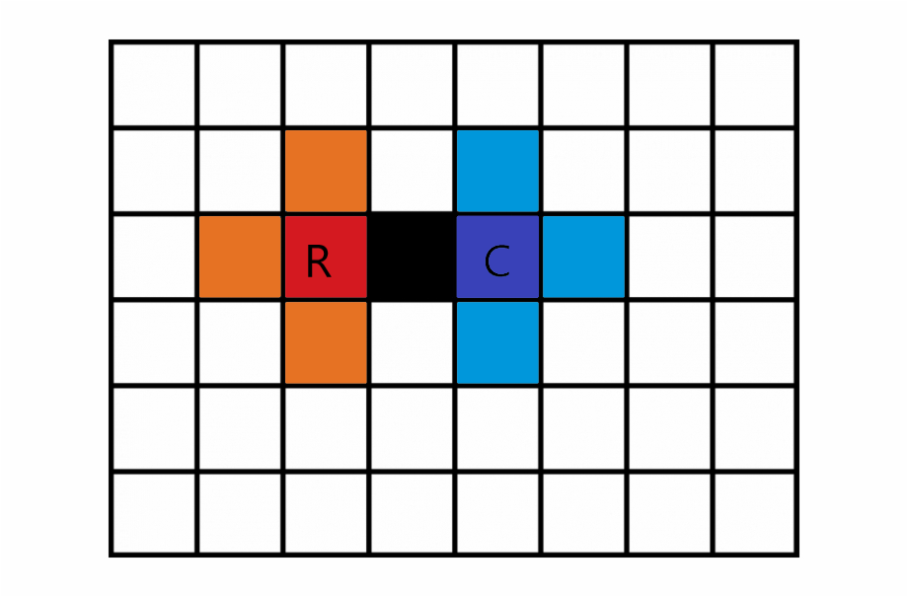
What is difference b/w this and James Bond example?

Slide 17
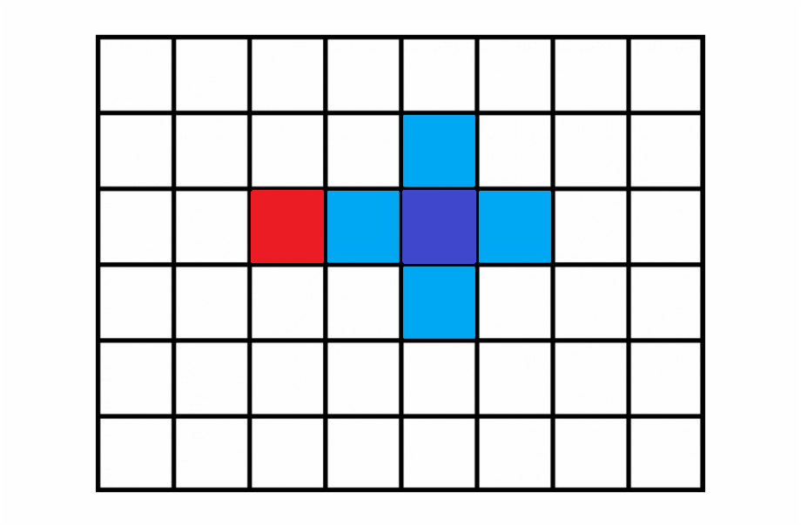
What if in our implementation the cat moves first!!
Then all thus positions will be marked unvisitable for Mouse in future!!

Slide 18
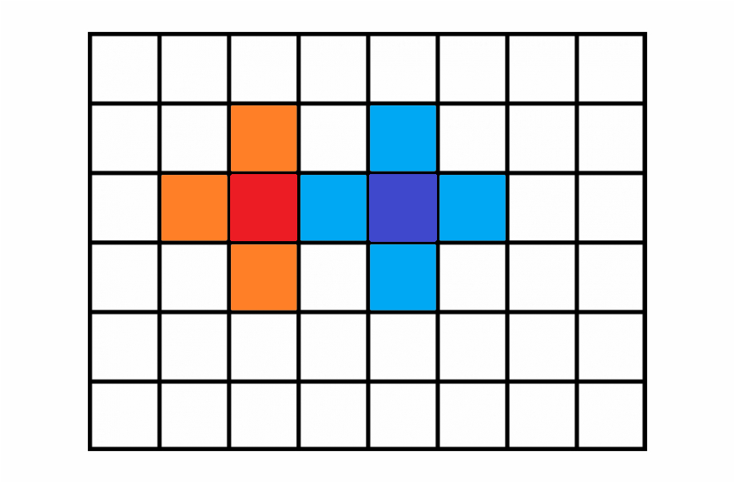

Slide 19
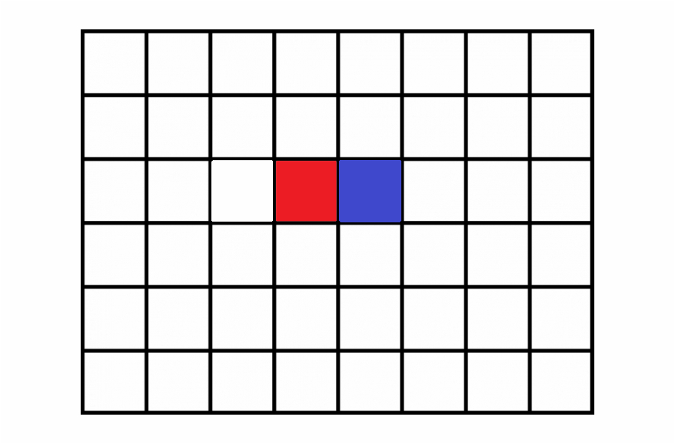
Another Case
R C

Slide 20
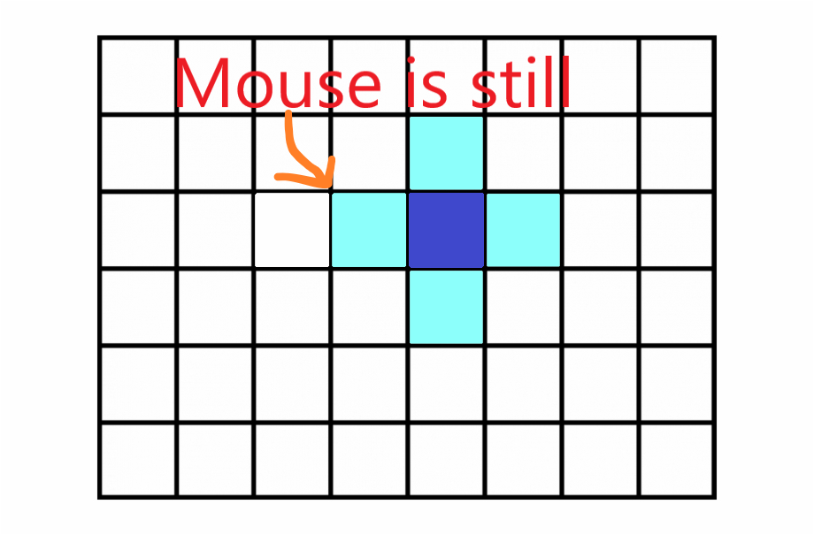
R C

Slide 21
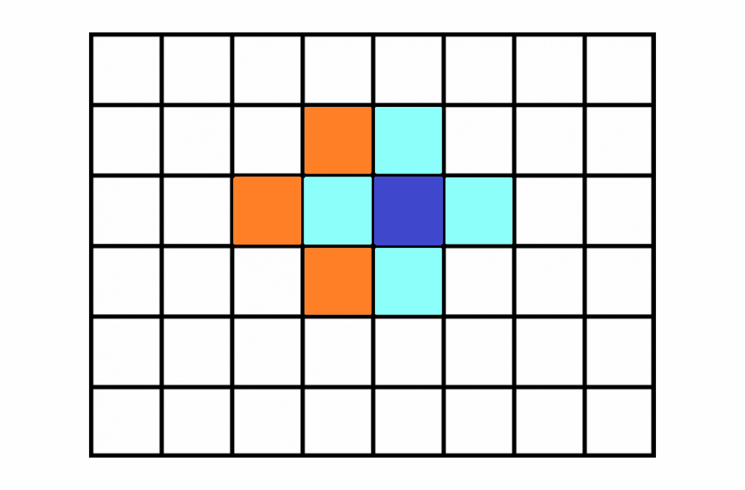
R C

Slide 22
Exit Condition
while(true)
{
If any of the mouse is on edge of the field or
all the places has been visited by cat then Exit this loop
Cats Makes all possible moves.
All thus places are marked as dangerous for mouse.
Mouse moves to all possible safe positions.
}

Slide 23
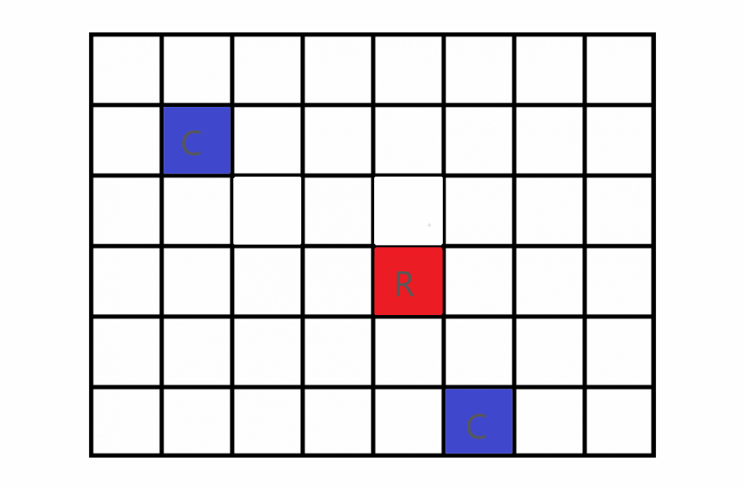

Slide 24
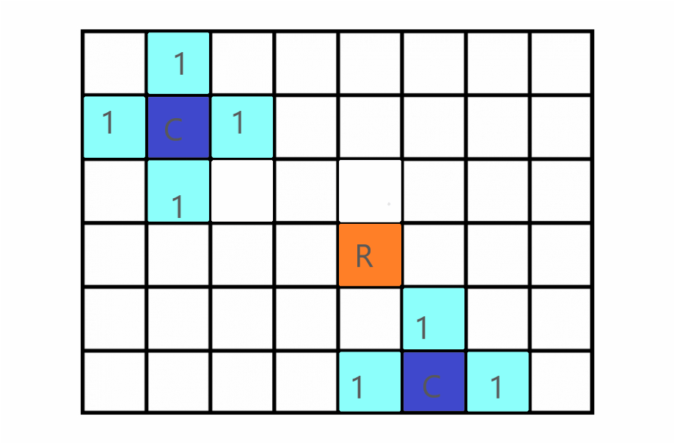
1st move of CAT

Slide 25
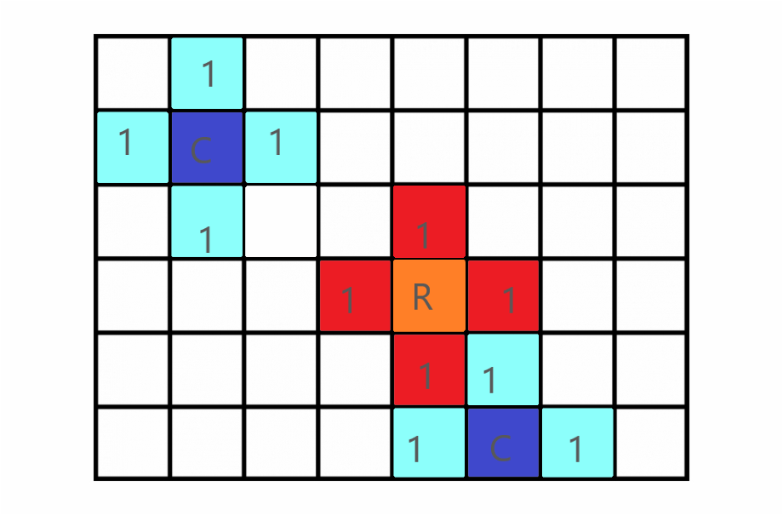
1st move of RAT

Slide 26
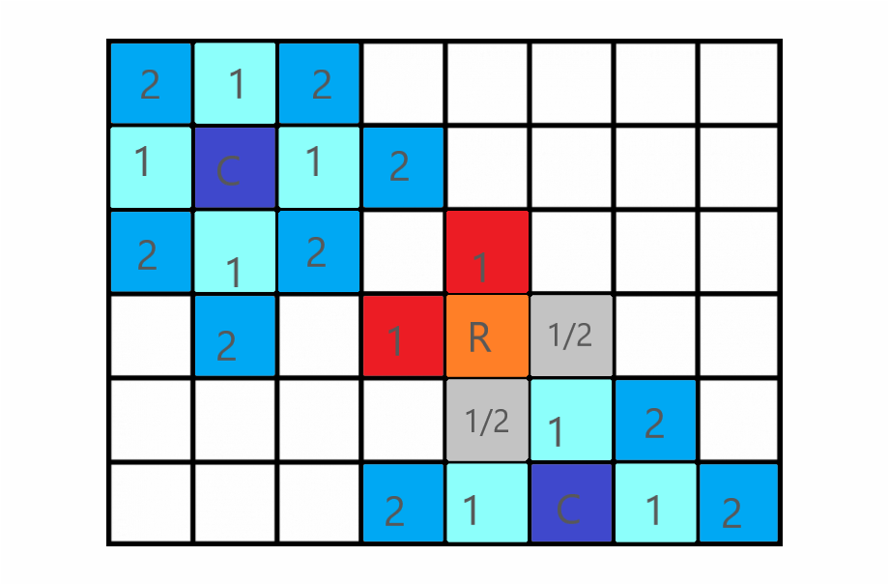
2nd Move of CAT
Previous New

Slide 27
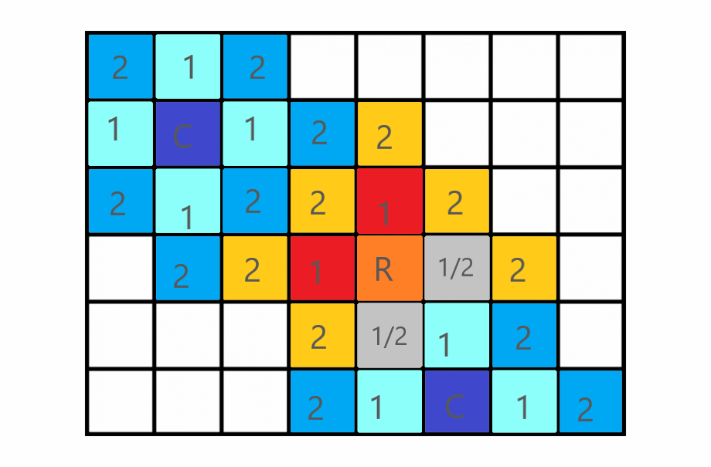
2nd Move of Rat. Notice the moves Cat can go ‘Befikre’, Mouse can’t.
Previous New

Slide 28
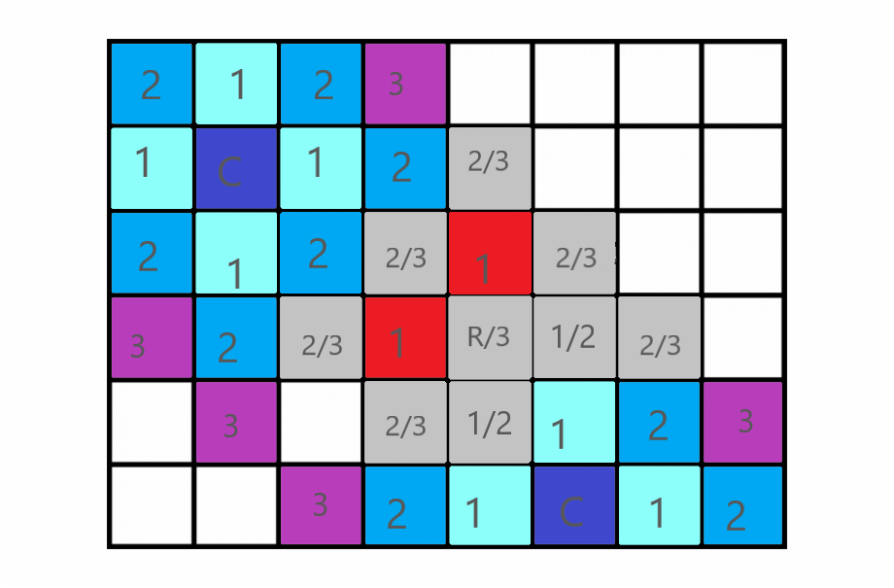
Cat 3rd Move (Diagrams will be confusing, just think about the concept, no need to focus on diagrams)
Previous New One

Slide 29
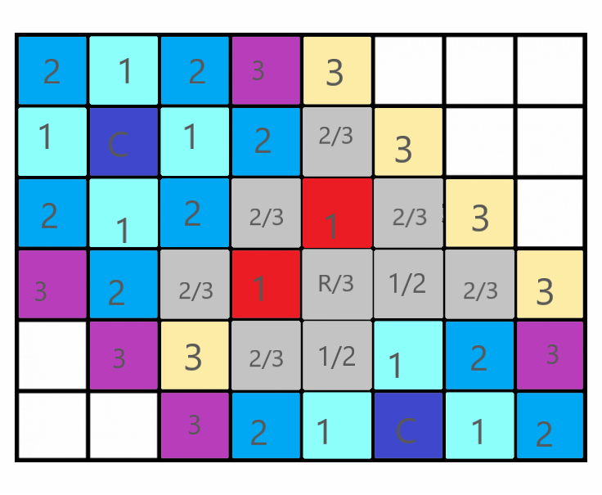
Rat 3rd Move
Previous Current

Slide 30
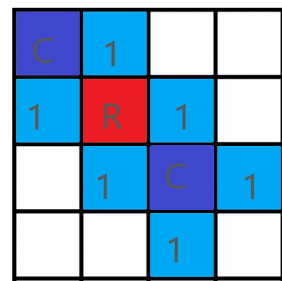
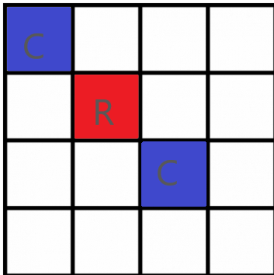
Another Case
Original positions After Cats first move, no position left for Rat.

Slide 31
Queue elements in James Bond were simple positions like [x,y].
This time it will also contain info about whose move is this - [x,y,R] or [x,y,C]
Let mouse position be rx and ry and cats be cx cy and dx dy-
Initial queue { [cx,cy,C] , [dx,dy,C], [rx,ry,R] }
-first Cat moves are inserted in queue.
-Cat can move to any place
-Mouse can only move to safe places
- If we encounter a queue element such that it is a Mouse move and it is on edge of graph, then its the end (mouse can escape)
-Otherwise if queue becomes empty then mouse cant escape.
-

Slide 32
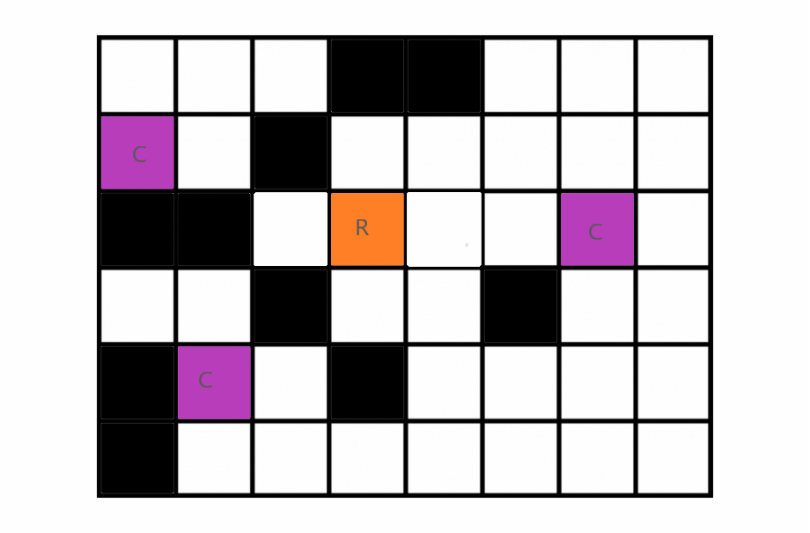
A more General question….

Slide 33
Slide no. 6 as reference
while(!Q.empty())
{
1)P=top element of queue.
2)Check for breaking condition
3)Pop out top element.
4)Insert all the new elements that can be inserted
}
1)P=[x,y]
2)Not satisfied
3)pop (x,y) from queue
4) insert these [x,y-1] [x,y+1] [x-1,y]

Slide 34
Diametre of Tree

Slide 35
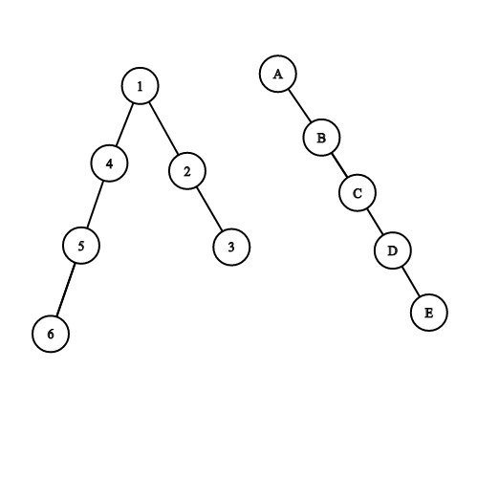
Different types of cases

Slide 36
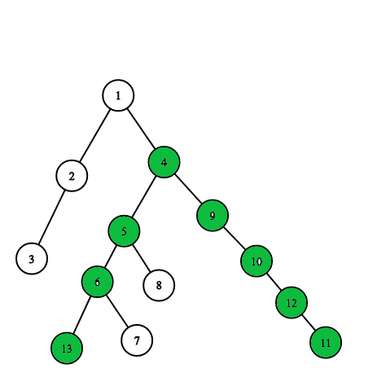
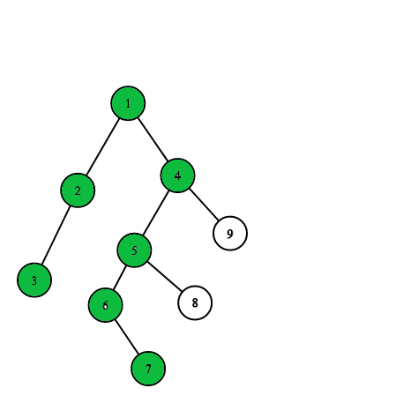
Examples- Fig 1 Fig 2

Slide 37
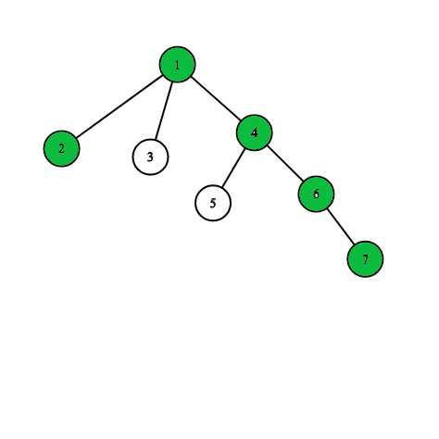
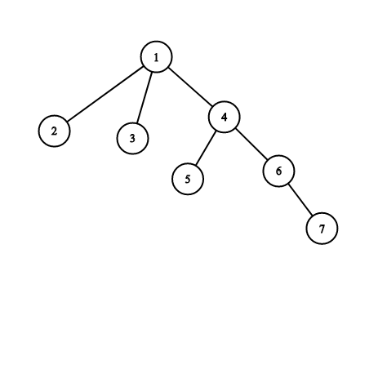
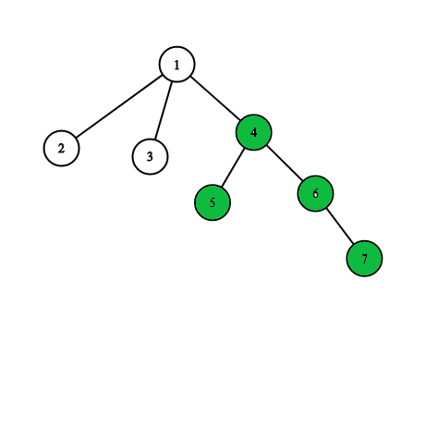
Strategy to find max diametre.

Slide 38
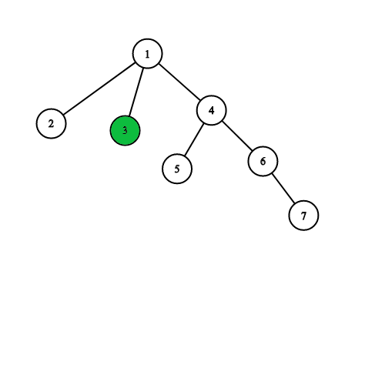
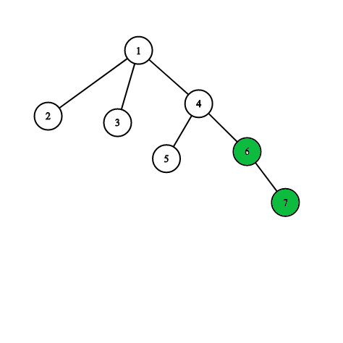
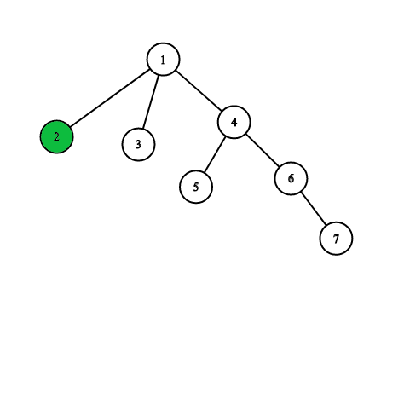
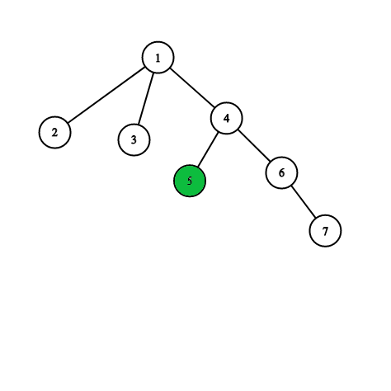
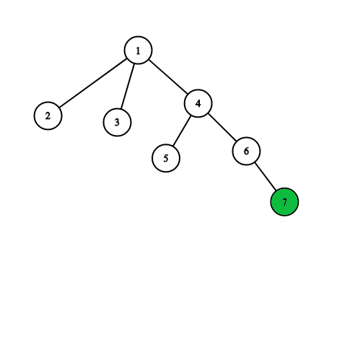
Social Message-
Boycott China

Slide 39
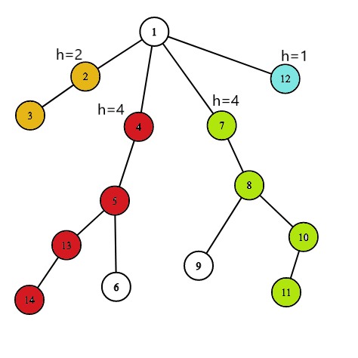
There are 4 choices {2,4,4,1} I will take maximum two
If we Know heights of children then we can find the maximum diameter for this subtree.

Slide 40
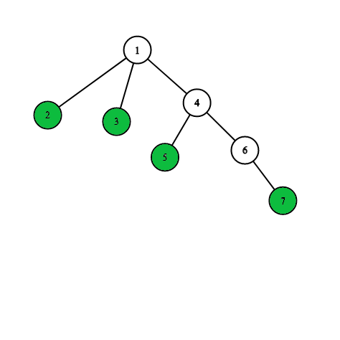
Heights and maximum diametre for leaf Nodes=1
If we can check that if a Node is Leaf than we can straight away say that its
Height=1
Diametre using that as top node=1

Slide 41
Resemblance to PMI
Base Case= we trivially prove for F(0) or F(1)
Propagation- We assume for F(k) it is true.
Final prove- We Prove it for F(k+1)
Base Case= Leaf Nodes, we know height and diametre=1.
Propagation- If we know about the maximum height of all children and maximum diametres for all nodes on a subtree, Then,
Final Prove- We can find Maximum diametre on this Node, we can also find maximum height on this node.

Slide 42
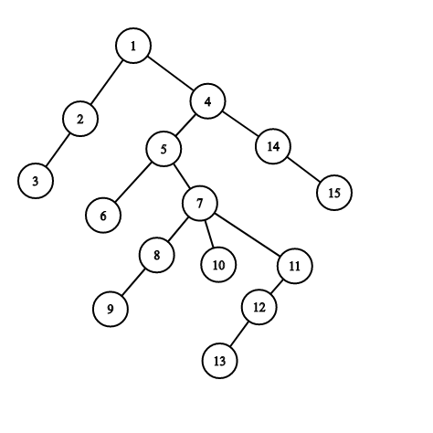

Slide 43
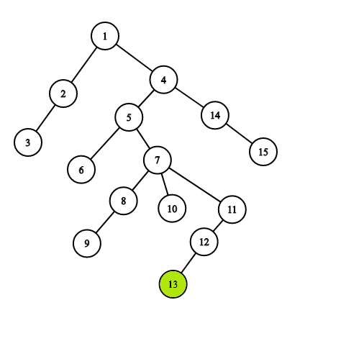
This is a leaf Node, which is a BASE CASE, If we Know a node is leaf, Then,
Height=1
Diametre=1

Slide 44
Using data for children, We find that For NODE 12,
Height = 2
Diametre using 12 as head=(1+0)+1 = 2
h=1

Slide 45
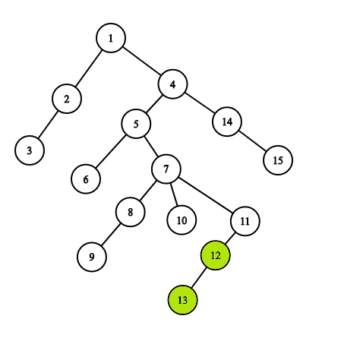
Using data for children, We find that For NODE 11,
Height = 3
Diametre using 11 as head=(2+0)+1 = 2
h=2

Slide 46
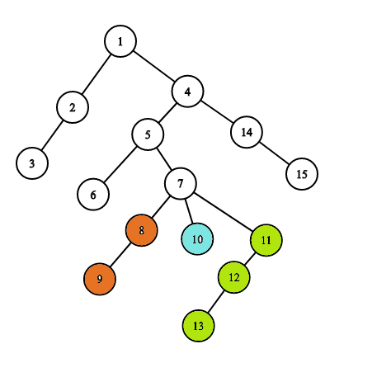
Using data for children, We find that For NODE 7,
Height = 4
Diametre using 7 as head=(2+3)+1 = 6
h=2
h=1
h=3

Slide 47
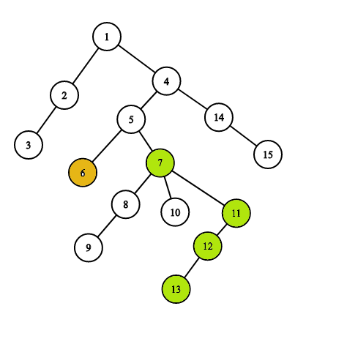
Using data for children, We find that For NODE 5,
Height = 5
Diametre using 5 as head=(1+4)+1 = 6
h=4
h=1

Slide 48
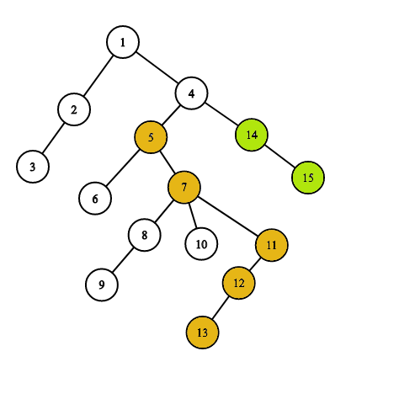
Using data for children, We find that For NODE 4,
Height = 6
Diametre using 4 as head=(5+2)+1 = 8
h=5
h=2

Slide 49
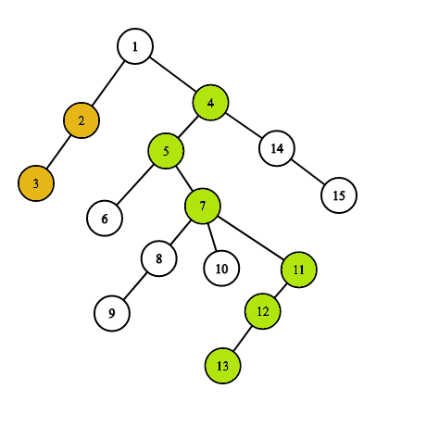
h=2
h=6
Using data for children, We find that For NODE 1,
Height = 7
Diametre using 1 as head=(2+6)+1 = 9

Slide 50
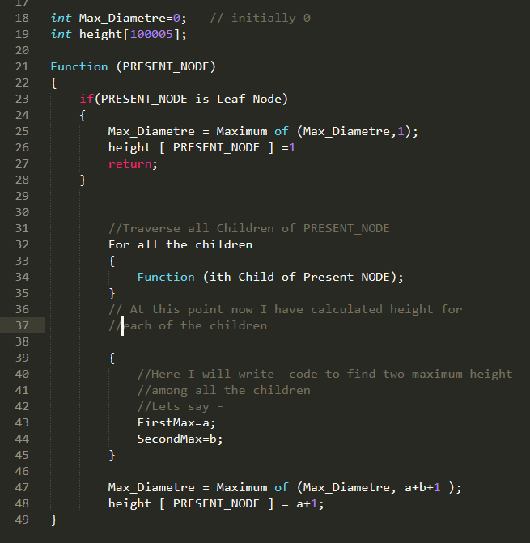
Pseudo Code

Slide 51
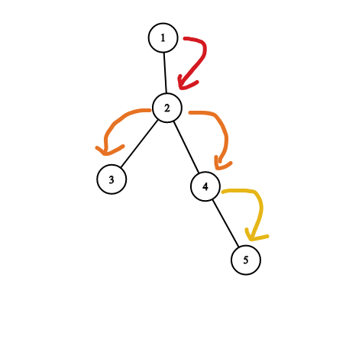
height=4
Max_Diametre=
Max(Max_diametre,4)
Max_Diametre is initially 0
height=3
Max_Diametre=
Max(Max_diametre,4)
height=2
Max_Diametre=
Max(Max_diametre,2)
Base Case
height=1
Max_Diametre=Max(Max_diametre,1)
Base Case
height=1
Max_Diametre=Max(Max_diametre,1)

Slide 52
height=4
Max_Diametre=
Max(Max_diametre,4)
1
height=3
Max_Diametre=
Max(Max_diametre,4)
2
height=2
Max_Diametre=
Max(Max_diametre,2)
Base Case
height=1
Max_Diametre=Max(Max_diametre,1)
3
4
Base Case
height=1
Max_Diametre=Max(Max_diametre,1)
5

